Slide 1
DEMYSTIFYING CRIME
NEW YORK CITY, USA
Notes:
Exploratory Data Analysis

Slide 2


Presenters
Team 6
Noopur Latkar
MISM-BIDA 16
Angel Lee
MISM-BIDA 16

Slide 3
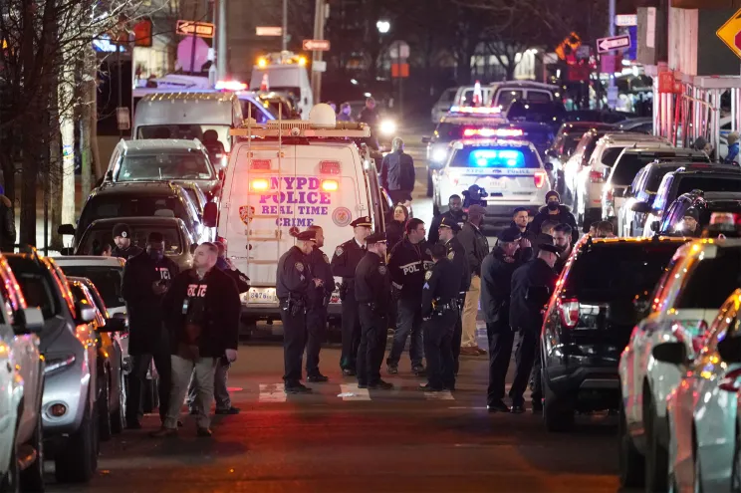

Motivation
Picture courtesy : Google
Astonishing 38.5% increase in overall index crime in NYC this year compared to 2021
Your chance of being a victim of violent crime in New York is 1 in 172
Finding patterns to inhibit crime
Criminal Profiling in Mindhunters
Reference : https://www.neighborhoodscout.com/ny/new-york/crime , https://www.amny.com/police-fire/new-york-city-crime-rates-january-2022/

Slide 4
Agenda
Crime Mapping
When and where are majority crimes happening? How has that changed over time?
Characteristics of criminals and their socio-cultural backgrounds
Gun violence and its distribution across different geolocations
Impact of social events on shootings incidents
Seasonal trends of shootings across months, days and hours

Slide 5
Key Findings
Crime Mapping
Majority crime distributed across Bronx and Brooklyn
Sudden drop in overall crime in 2017 (policy change)
Majority criminals are Black, but so are the victims
Decrease in overall crime but increase in shooting incidents in 2020, 2021
Maximum shootings observed on 4th of July, 31st Dec
Shootings spike considerably in summer months, and during wee hours of the night
Huge parity in male victims and female victim numbers across all genders

Slide 6
Key Datasets
NYPD Court Summons Data (2006 - 2021)
https://data.cityofnewyork.us/Public-Safety/NYPD-Criminal-Court-Summons-Historic-/sv2w-rv3k
5.3M observations
NYPD Shooting Incident Data (2006 - 2022)
https://data.cityofnewyork.us/Public-Safety/NYPD-Shooting-Incident-Data-Historic-/833y-fsy8
https://data.cityofnewyork.us/Public-Safety/NYPD-Shooting-Incident-Data-Year-To-Date-/5ucz-vwe8
25.6K observations
New York State Crime Type (1990 - 2018)
https://www.kaggle.com/new-york-state/new-york-state-index-crimes
Notes:
Here listed the datasets we’ve used. The first is the Court Summons Data, consisting of 5 million rows, which provide us an overview on the types of crime and the characteristics of the person that committed that crime. The second and third dataset focus on crime type, crime location, and criminal background for all types of crime, with the second data focusing on shooting incidents, as we would like to deep dive on analyzing a more serious kind of crime and how to prevent it from harming the general public in the future.

Slide 7
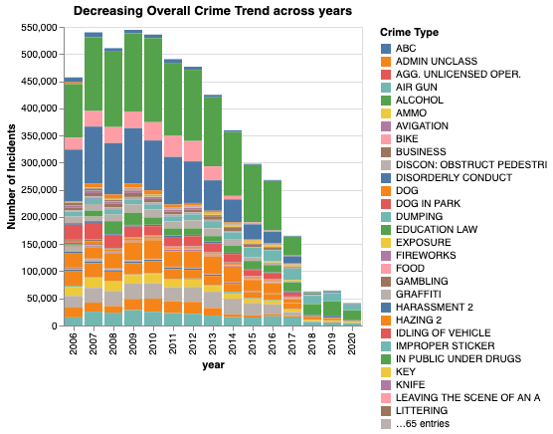
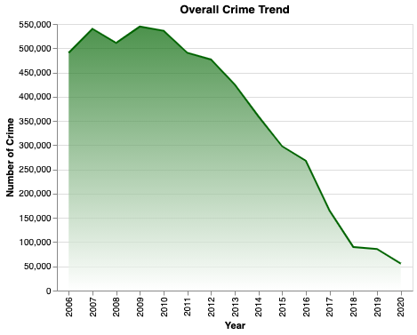
Overall Crime Trend
(2006~2020)
Decreasing Trend
Notes:
We first look at the overall crime trend over the years, and how the types of crime has shifted over the years. There are 60-ish categories of crime, including major and minor crimes. Looking at this chart, we decided to deep dive on the reason behind the drop in recent five years to understand the reason behind decreasing number of crimes.

Slide 8
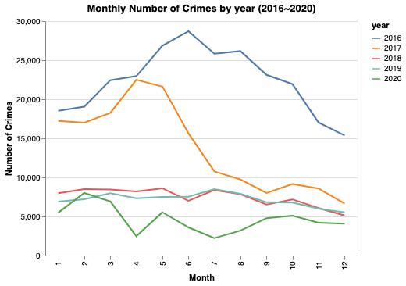
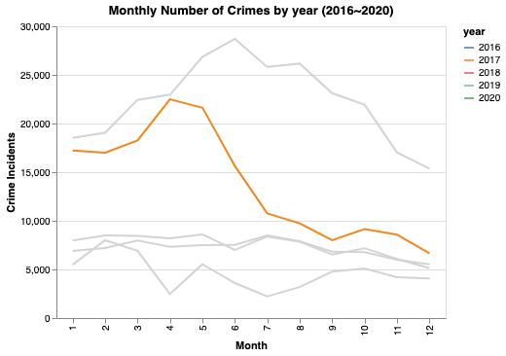
Exploring monthly crime trend
April 2017 sees a sharp decrease, continues to 2018
Notes:
Next, by exploring the monthly number of crime over the past 5 years, we found out that there is a great reduction of crime in summer 2017.

Slide 9
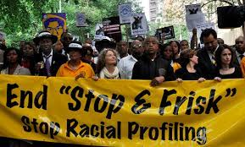
Insights
Abandonment of NYPD’s Stop-And-Frisk Program
Stop, question, and search civilians on the street for weapons and other contraband
Based on mere suspicion of wrongdoing
About 83% of the stops between 2004 and 2012 involved Black and Latino people
Racially discriminatory and unconstitutional
Picture courtesy : Google
Reference : https://eji.org/news/new-york-crime-falls-as-police-end-stop-and-frisk/
Notes:
We further researched outside of the dataset, and found out that NYC abandoned the stop-and-frisk policy in 2017. The stop-and-frisk poicy allow polices to stop suspicious people on the streets and many people were being searched for and convicted for minor crimes. This policy was racially discriminated and unconstitutional, as 83% of the stops involve black and latino people, therefore it was ordered to stop. After the abandon of the stop-and-frisk policy, the total number of crime decreases, and has stayed so after that.

Slide 10
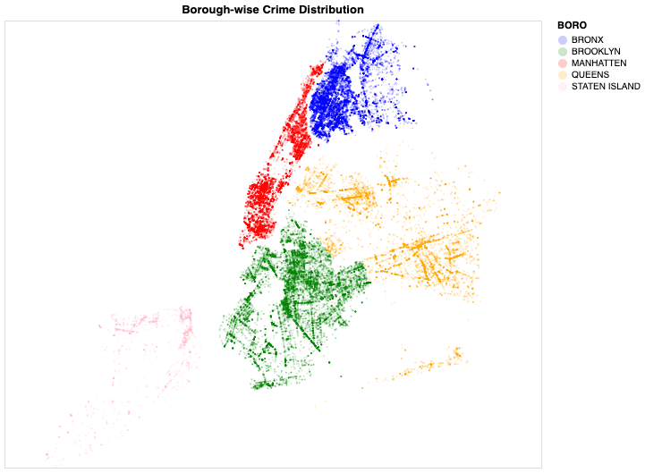
Crime Distribution across NY boroughs
(2019)
Majority total crime concentrated in Brooklyn, Bronx, Manhattan
Least total crime in Staten Island
Notes:
As new york city is consists of 5 main boros, we found out that the top three concentrated areas where crime happened are Brooklyn, Bronx, and Manhatten. People should be more aware of their surroundings when they are in these areas, and this could be a reference for the police department to more efficiently allocate their officers in different areas.

Slide 11
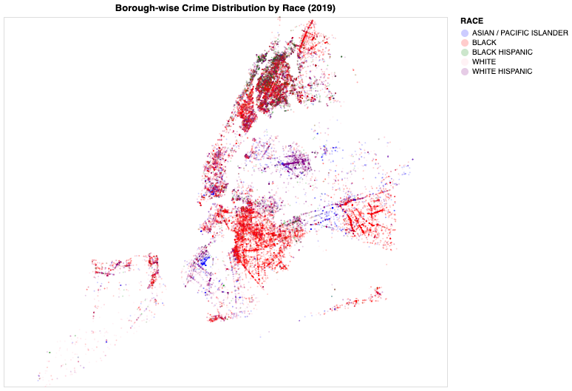
Race and Geolocation of Criminals
(2019)
Majority crime in Brooklyn by Blacks
Majority crime in Bronx by Blacks and Black Hispanics
Crime in North Queens dominated by Whites and White Hispanics
Concentration of Asian criminals in South Brooklyn
Notes:
We further explored the race of the person that commited crime. The red dots are crime committed by the black race, and they are more concentrated in Brooklyn and Bronx.
Next, we observe that crimes committed by white hispanics, the purple dots, are more likely to happen in Northern Queens.
These color distribution shows that It may be that blacks are more often incorrectly convicted as there may be racially discriminated actions, as we learned that from the stop-and-frisk policy.

Slide 12
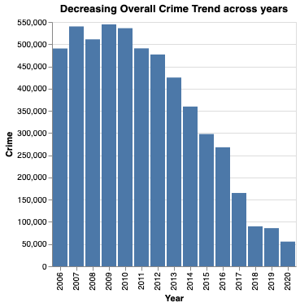
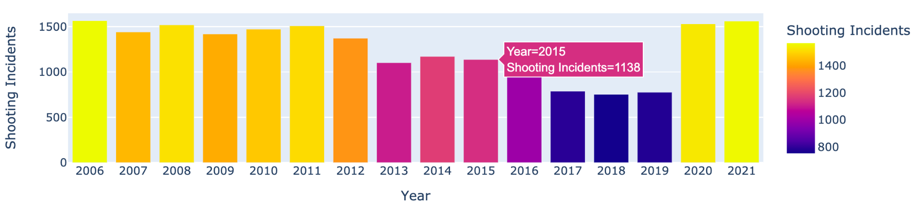
Major Crime Trend
(2006~2021)
Overall crime on a decline
Shootings (major crime) spike
in 2020, 2021

Slide 13
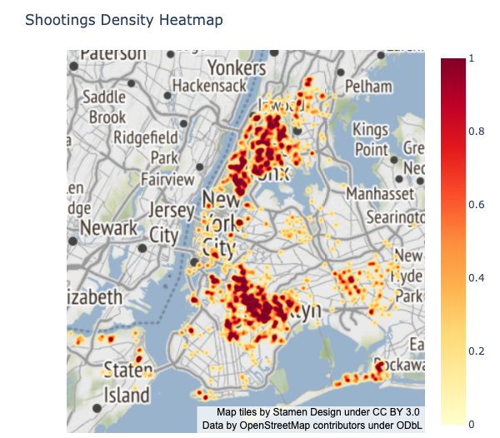
Shooting Incidents across Geolocation
(2020)
Majority shootings concentrated in Bronx and Brooklyn
Crime rate in Staten Island lowest in NYC (safest place)
Reference : https://www.neighborhoodscout.com/ny/staten-island/crime#description

Slide 14
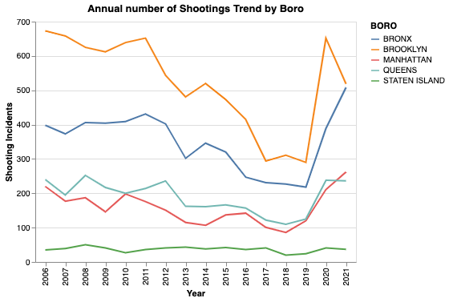
Year-wise Shooting Incidents across Boroughs
Bronx and Brooklyn
Drop in 2018 : Lowest levels in more than six decades
Bronx and Brooklyn
Spike in 2020 : Most shootings in any year in the last decade

Slide 15
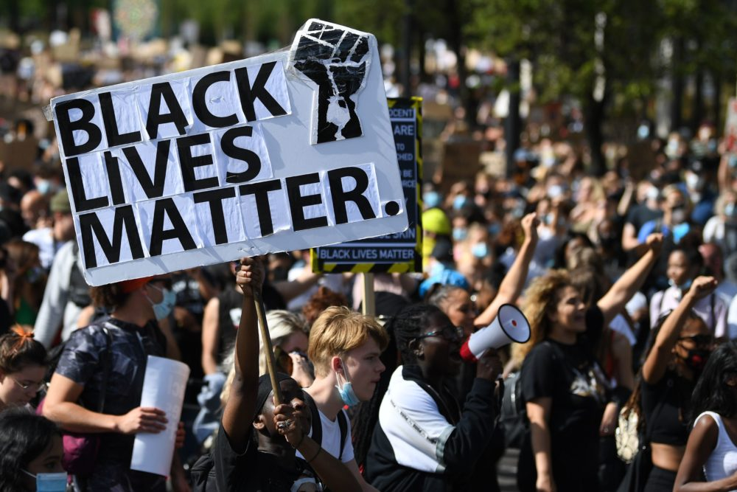
Insights
1. Black Lives Matter protests
Death of George Floyd in May, 2020
Protests reinforced communities’ distrust of law enforcement
Protests scared law enforcement officers from doing proactive policing necessary to prevent crime
Criminals have emboldened as police back off from aggressive tactics
Picture Courtesy : Google
Reference : https://www.vox.com/policy-and-politics/2017/9/25/16360606/murder-rate-2016-fbi
Notes:
Inspite of this unfortunate incident that led to the protests, its important for the police dept to continue strict patrolling, but ensure its fair across all genders and races.

Slide 16

Insights
2. Impact of COVID
Economic and physical strain of the virus
Covid disproportionately took lives in neighborhoods that were already struggling with high levels of gun violence
Overall increased agitation amongst people from weak economic backgrounds due to helplessness
Unemployment rate on a rise
Picture Courtesy : Google
Reference : https://www.thecity.nyc/2020/12/21/22189682/why-are-shootings-up-in-new-york-city-in-2020-nypd
Notes:
Government should be sensitive to this situation and extend maximum support to people with weak economic backgrounds

Slide 17
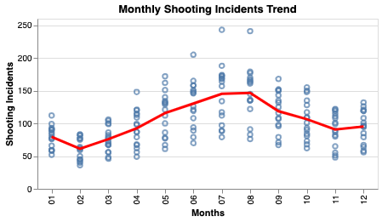
Shooting Incidents : Months of the year
(2006~2021)
Increasing trend from
May ~ Sept
Maximum shootings in summer season
Peaks in August
Notes:
As we would like to explore the monthly trend of shooting incidents, we plotted the number of shootings incidents of each year, and calculated the mean of that month as the red line. We found that the number of shootings increase during the summer season and peaked in August. This could be a reference for the police to allocate police officers to focus on preventing shootings during the summer.

Slide 18
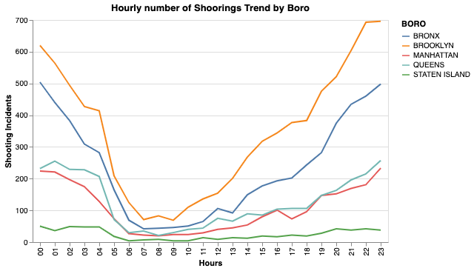
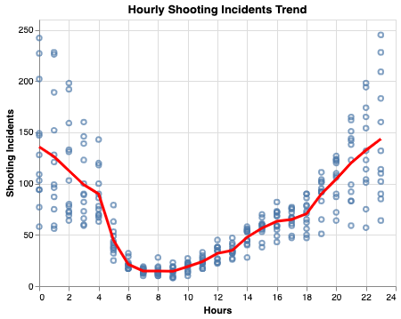
Shooting Incidents : Time of the day
(Jan~Dec)
(2006~2021)
General trend across all boroughs
Notes:
We plotted the number of shooting incidents across the 24 hours of a day. And the trend is obvious that safer hours are from 5am to 5pm, and the more dangerous hours are during night time. This trend is the same across all boros.

Slide 19
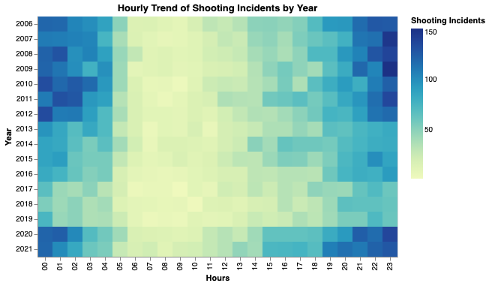
Insights
Lowest number of shootings
5:00 am to 5:00 pm (safest time)
Majority shootings between
10:00 pm to 3:00 am (unsafe time)
Notes:
We visualize the trend across the years with this heatmap, and the insights are the same.

Slide 20
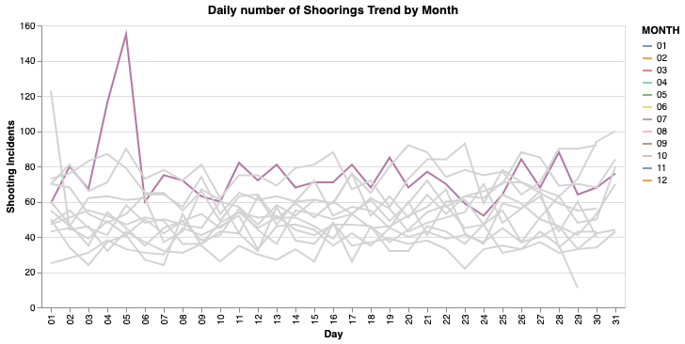
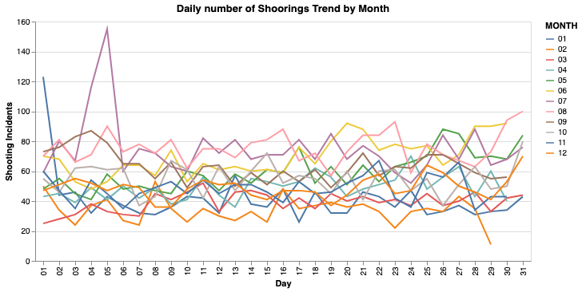
Shooting Incidents across days of the month
(2006~2022)
Sudden spike in shootings in July
Notes:
We’ve plotted the number of shooting incidents across all days of the month, and each line represent a month. We’ve found that the most shootings through the year have been on exactly ONE day, the 4th of July. It is to our surprise as we thought that this is a day when most people go out and celebrate.

Slide 21
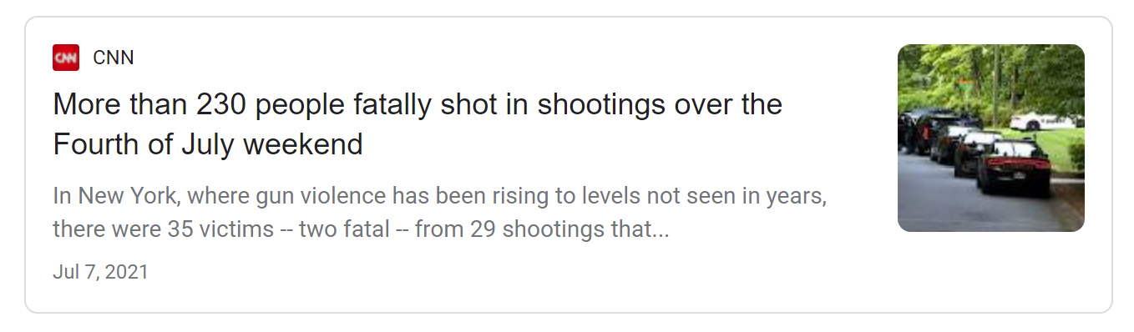
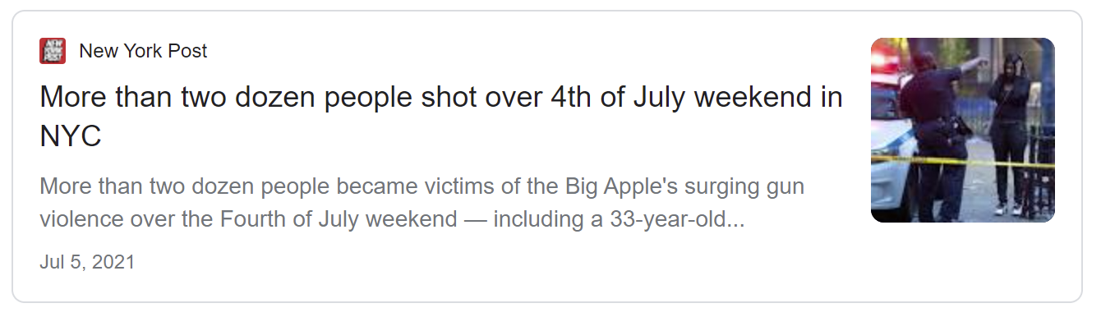
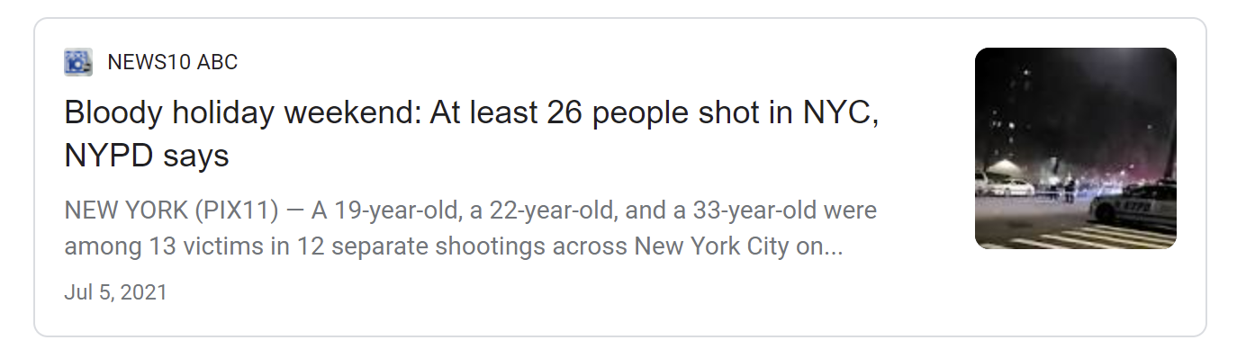
Insights
Maximum shootings on 4th of July : Independence Day
Reference : https://www.insider.com/mass-shootings-in-us-over-fourth-of-july-weekend-2021-7
Notes:
As we deep dived into past news, we found that 4th of july is a day a day when people with the intend to draw attention to plan and execute shootings. This insight could be used as a reference for the police department to monitor and increase security level before 4th of july to prevent shootings from happening in the future.

Slide 22
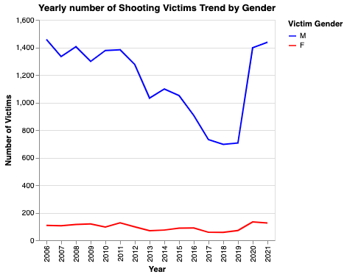
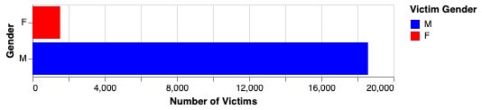
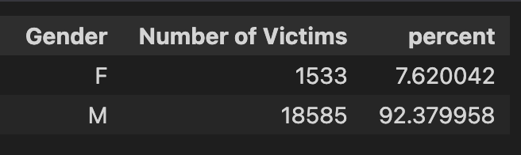
Victims plotted against gender

Slide 23
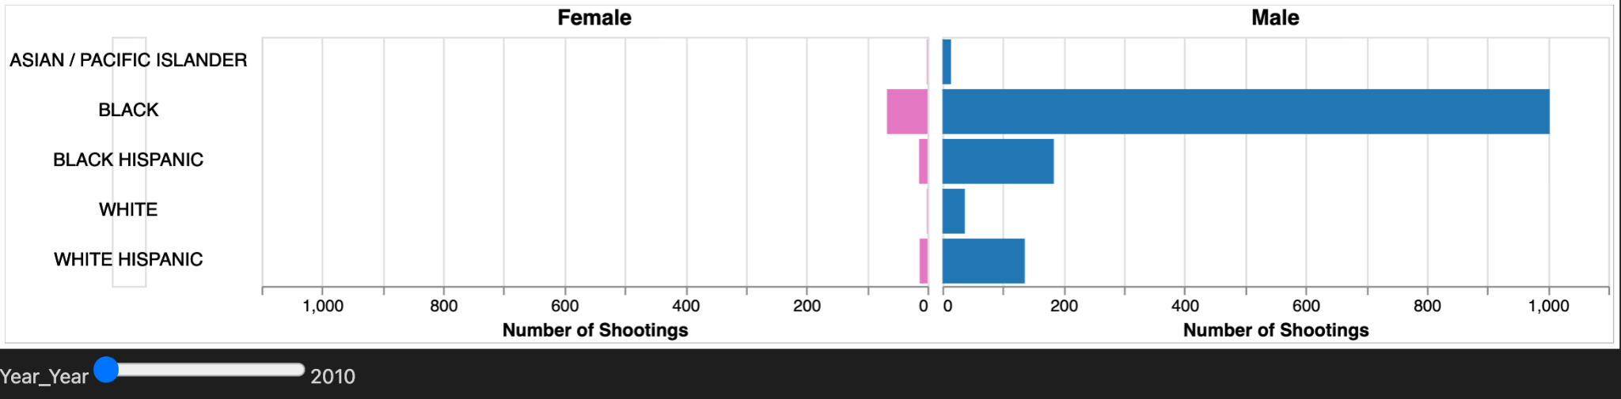
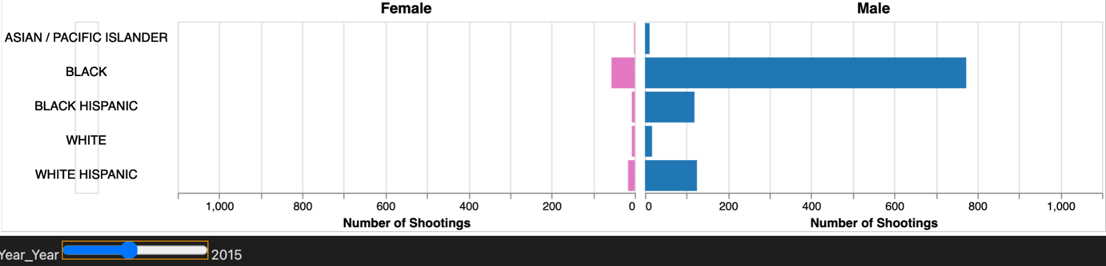
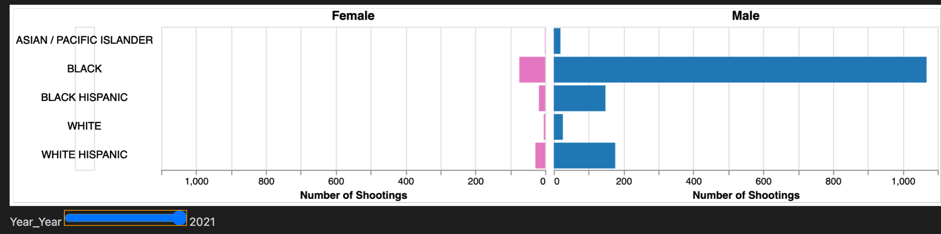
Victims plotted against race and gender
Victim numbers decline from 2010~2015
2010
Victim numbers increase from 2015~2021
2021 witnessed maximum shooting victims
2015
Majority victims -> Black Males
Black hispanics targeted more than white hispanics, has changed over time
2021

Slide 24
Future scope
Thank you!
Implement Geospatial Clustering to find unsafe neighbourhoods using lat-long features
Maximize the coverage of police patrolling at identified unsafe areas at particular timings, by involving police patrolling schedules in the analysis

